Slide 1
Food Security Monitoring for Karamoja Region(2017)
Group 12’s Presentation for Project 2 under Data Visualisation

Slide 2
Introduction
Karamoja is the most food-insecure region of Uganda which is mainly due to low crop productivity level caused by intense droughts as well as pest and disease outbreak.
Several NGO's provide technical and farm inputs to farmers experiencing extremely low yield which they often need to rely on some very local sources of information to prioritize their activities.

Slide 3
Objectives
Dalberg Data Insights (DDI) has been requested to develop a new food security monitoring tool to support the decision making of one of those NGOs active in Karamoja.
This will be possible by developing an interactive visualization tool of the results for this first crop season which will be used as the first mockup of the Food Security Monitoring tool that DDI will develop for the NGO.

Slide 4
Dataset Overview
Geography: District & Sub County level(Uganda)
Crops: Sorghum + Maize
Metrics: Yield per Hectare, Production, Crop Area, Population
Derived Metric: Yield per Capita (Kg/person)
Geospatial Data: District & Sub County shapefiles

Slide 5
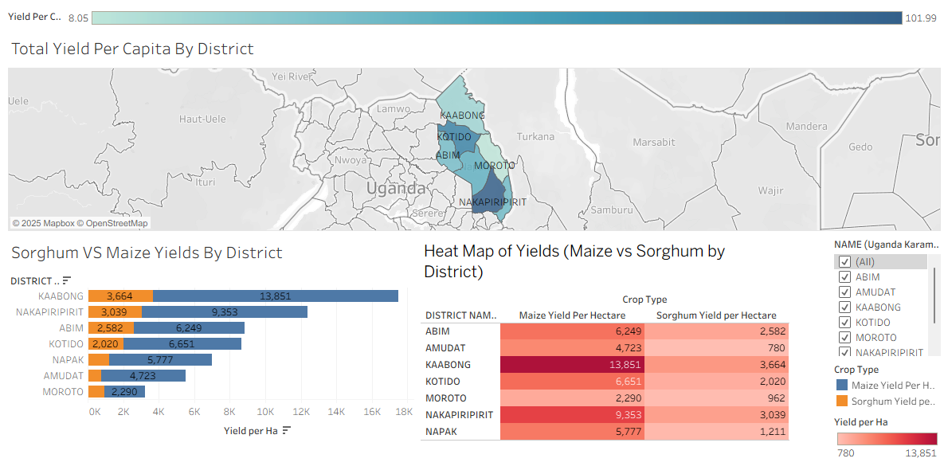
Dashboard preview( Karamoja Districts)
The dashboard hold the statistical visualisations for districts mainly being crop comparisons and subcounty rankings.
To make it interactive, filters for crop type and administrative level are present.

Slide 6
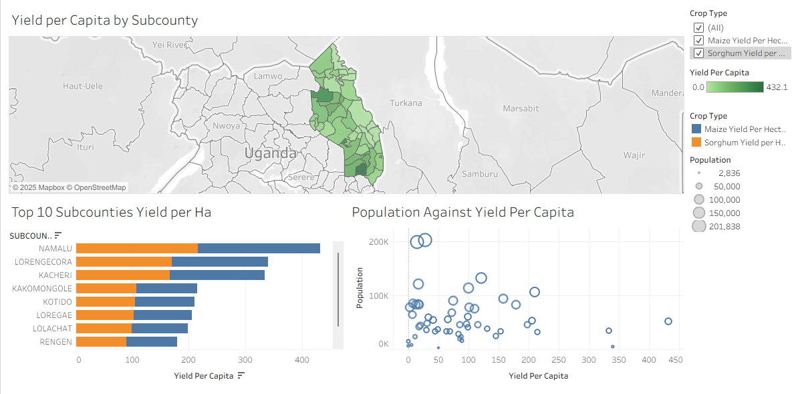
Dashboard preview(Karamoja Subcounties)
The dashboard hold the statistical visualisations for sub counties mainly being yield per hectare comparisons against population and subcounty rankings.
Crop type filters are implemented for interactivity and hands on preview.

Slide 7
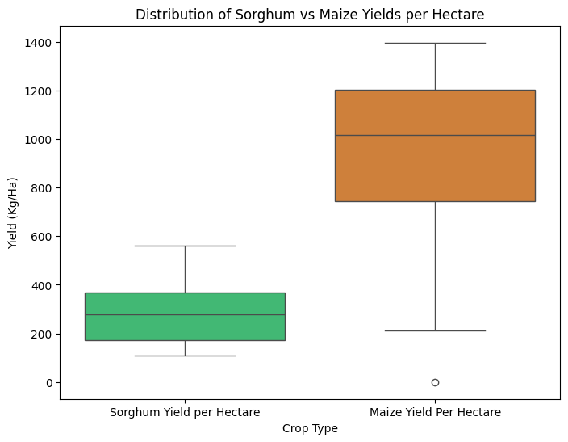
Key Visualisation 1 - Yields Distribution
Sorghum yields are more stable in comparison to maize.
Sorghum has a tight spread and short whisks while maize has a large spread paired with long whisks.

Slide 8
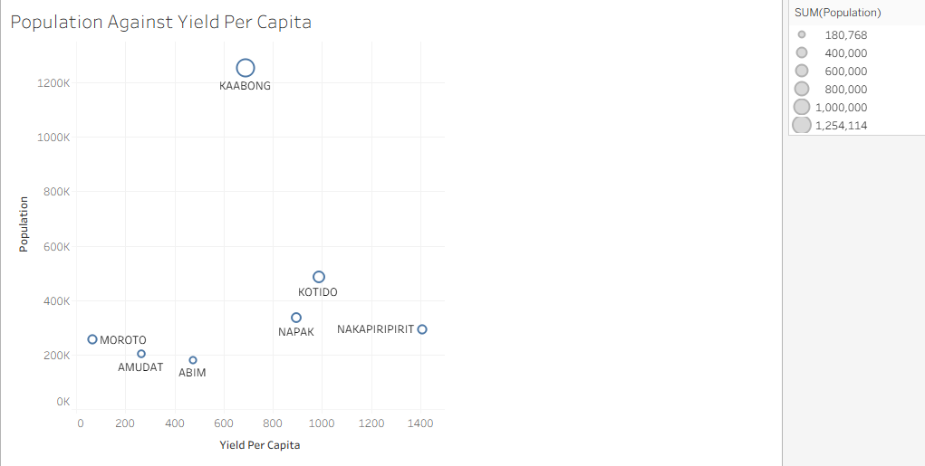
Key Visualisation 2 - Yield per Capita(Districts)
Despite Kaabong having the most population, it doesn’t produce the highest yields while Nakapiripirit holds almost the same population numbers as Moroto but has the highest yield per capita.

Slide 9
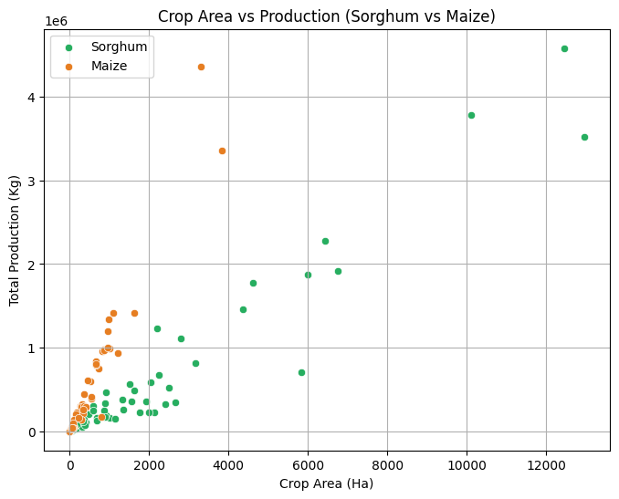
Key Visualisation 3 - Land Use Efficiency
From the plot, we can see that for maize, crop area does not correspond to the total production but for sorghum; the more the crop area the higher the total production.

Slide 10
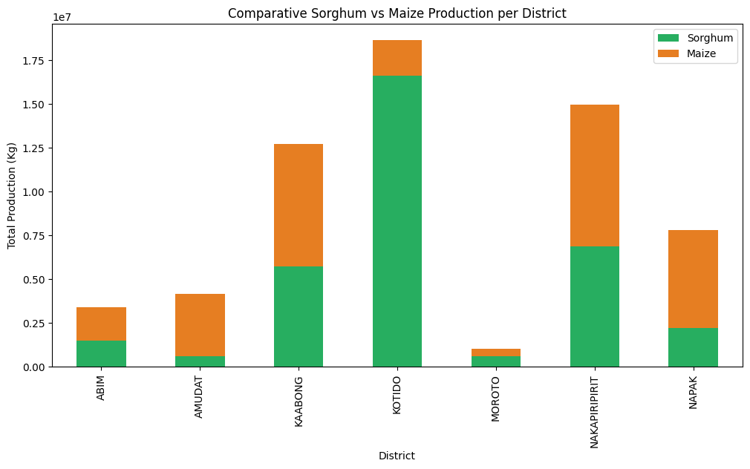
Key Visualisation 4 - Crop Dependency
We can see from the chart that no district heavily depends on maize other than Napak and Amudat rather it is almost equal or sorghum is heavily depended.

Slide 11
Food Security Recommendations
1. NGOs should scale maize as a more predictable food source since it is more stable.
2. They should invest in drought and pest-resistant varieties of sorghum as it has no outliers and has a tight spread range of productivity.
3. Districts with high yield per capita ( Nakapiripirit and Kotido ) could serve as redistribution hubs / surplus zones due to their high yield.
4. Districts / Sub Counties should increase crop area for sorghum as it directly corresponds to the production of the crop.
5. If the NGOs are aiming for high crop production, then they should prioritize sorghum, as districts with high production do so or aim for an even 50/ 50 together with maize.

Slide 12
Future Work
Addition of rainfall and climate inputs in the datasets for predictive modelling and analysis.
An extended analysis to multiple years would be great for identifying and monitoring trends.
Data integration of pest and disease outbreaks would suffice to help in interpretation of dependency and efficiency of crops.

Slide 13
Thank You
Thank you for your attention and articulation of this presentation.
For any questions, reach out to : koech.kipchumba@moringaschool.com

Slide 14
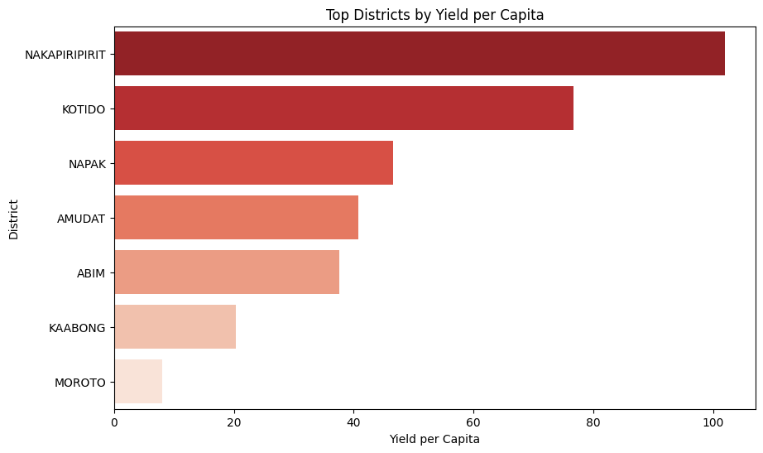
Appendix

